Slide 1
Guest Lecture Stanford ME469: SPD Computational Fluids Dynamics Research Interest
Stefan P. Domino
Computational Thermal and Fluid Mechanics
Sandia National Laboratories SAND2018-4536 PE

Slide 2
SPD Computational Fluid Dynamics Research Interest: Outline
Overview of Fluid Applications of Interest to SPD at Sandia National Labs
Evolution of how Modeling/Simulation Shaped Fire Physics
Multi-physics Coupling Examples
Wind Applications and Other non-Reacting Examples
Computational Scales of Interest
Conclusions
Lecture Overview

Slide 3
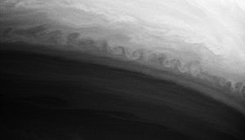
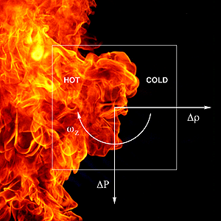
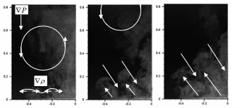
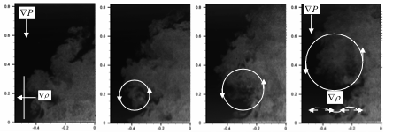
Consider the Abnormal/Thermal Environment
Characterized by a highly sooting, turbulent, reacting flow with Participating Media Radiation (PMR) and Conjugate Heat Transfer (CHT) mutiphysics coupling
Time-averaged (inset transient)
Vorticity generation

Slide 4
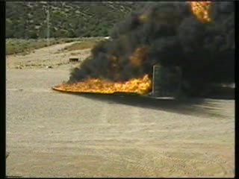
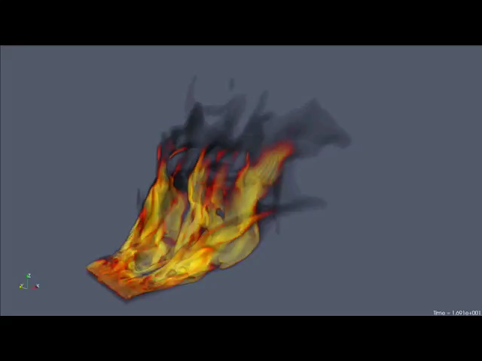
Evolution of a Mindset….. Cross Flow
LES of pulsed jet in cross flow; Coussement et al, JFM, 2012
Conclusion: The inclusion of a cross-flow wind profile couples vorticity of the pool and streamwise momentum which drives the formation of column vortices, increases the importance of mixing and, therefore, convective loads on the object become more important
Change in mindset: Invest in validation use cases to highlight the importance of fire accident scenarios in the presence of an external momentum field
Ten meter (top) experiment and
three meter (bottom) simulation

Slide 5
Evolution of a Mindset….. Whirling-like Flow
Brush fire (Curtin Springs, Australia)
Fire whirls from a 3-meter diameter pool in the Fire Laboratory for Accreditation of Modeling by Experiment, or FLAME, facility at Sandia National Laboratories. (Photo by Richard Simpson; A. Hanlin, lead experimentalist)

Slide 6
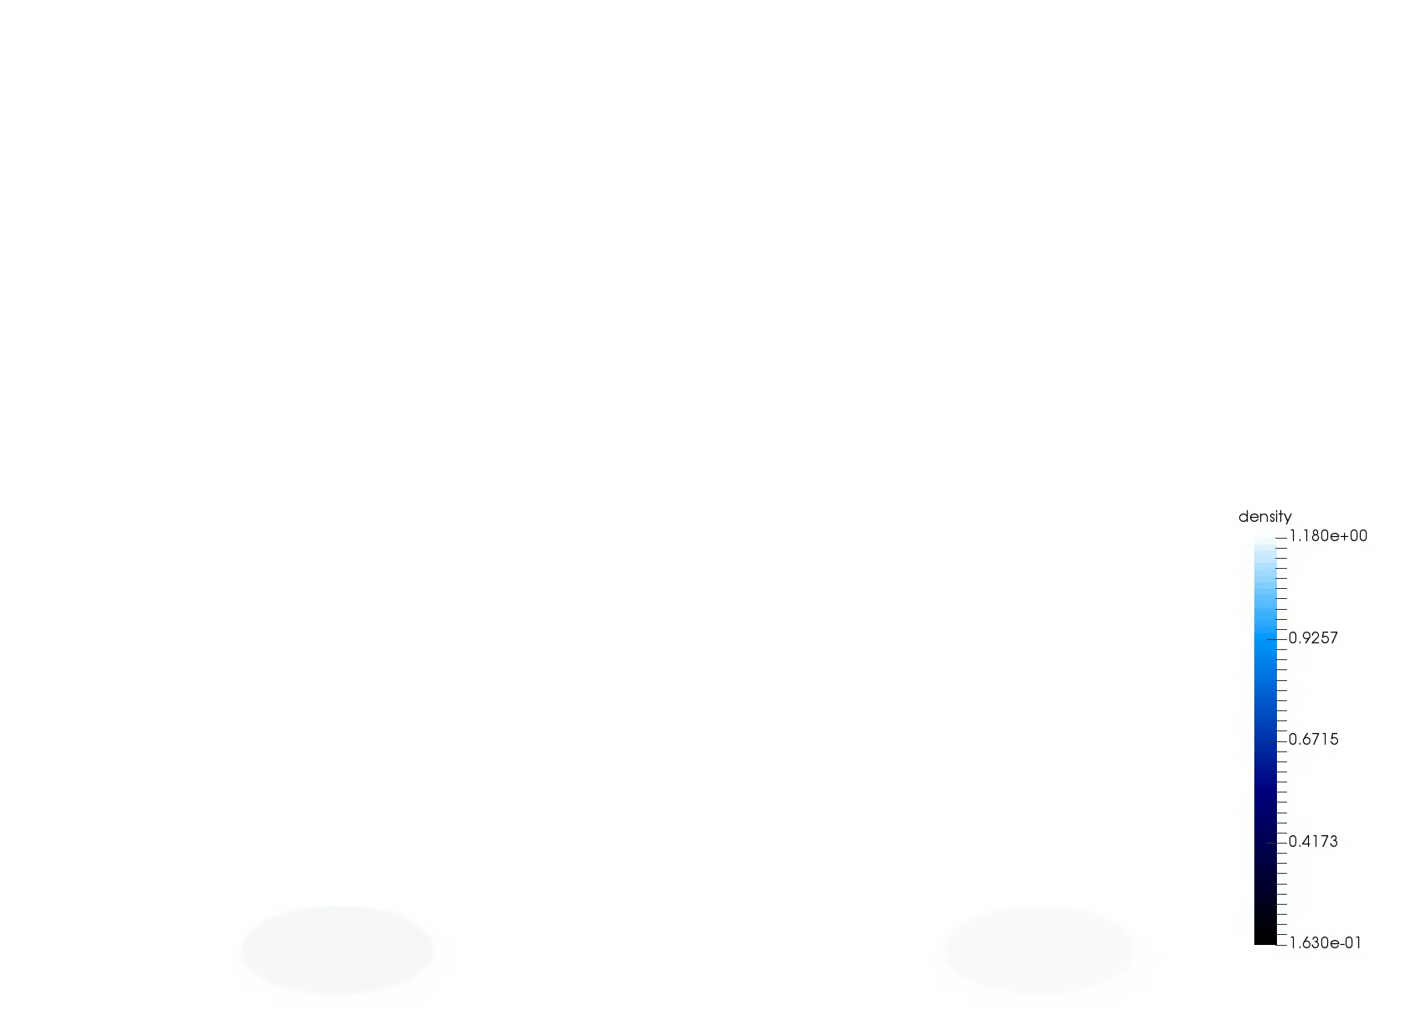
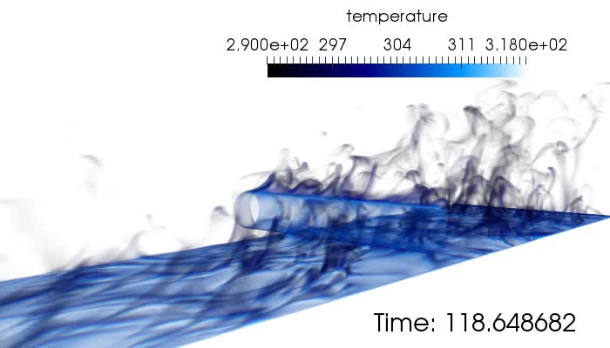
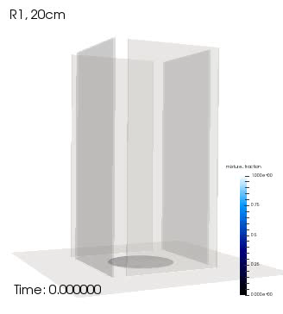
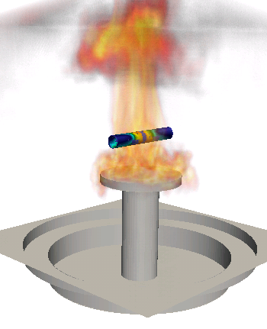
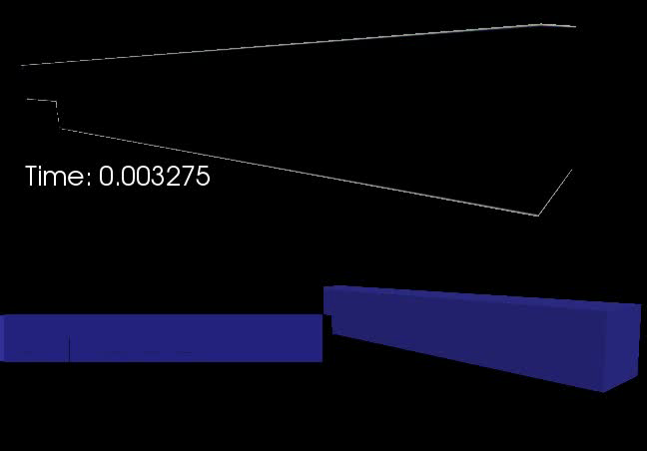
Several Multi-physics Flow Examples
Cylinder in cross flow
Helium plume (low-/high-order)
Object-in-fire
Heated backstep
Whirling behavior

Slide 7
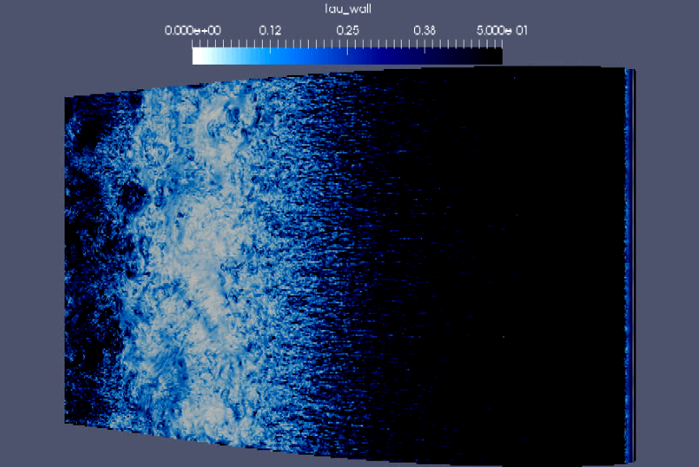
Wind Energy Applications… Towards Exascale (10¹⁸ FLOPS)
High Performance Computing (HPC) enables science
High Reynolds number flow past a wind energy turbine blade section
(Barone and Domino, 2016), ~1800 year simulation on one CPU
Late Roman Timeline 250 AD - 300 AD
250 AD: The Goths invade Anatolia (AKA, Asia Minor), in sea-borne raids they plunder Nikopolis

Slide 8
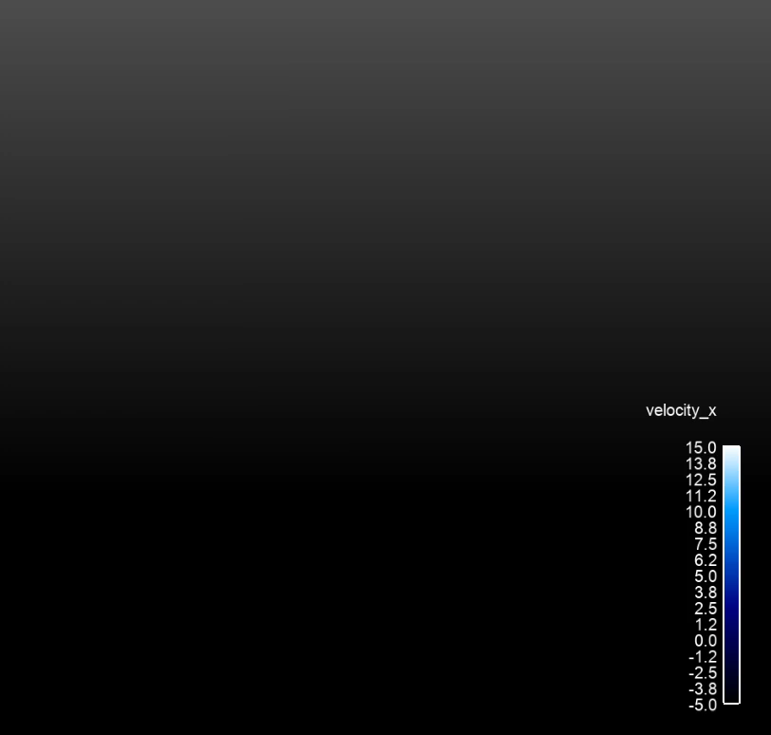
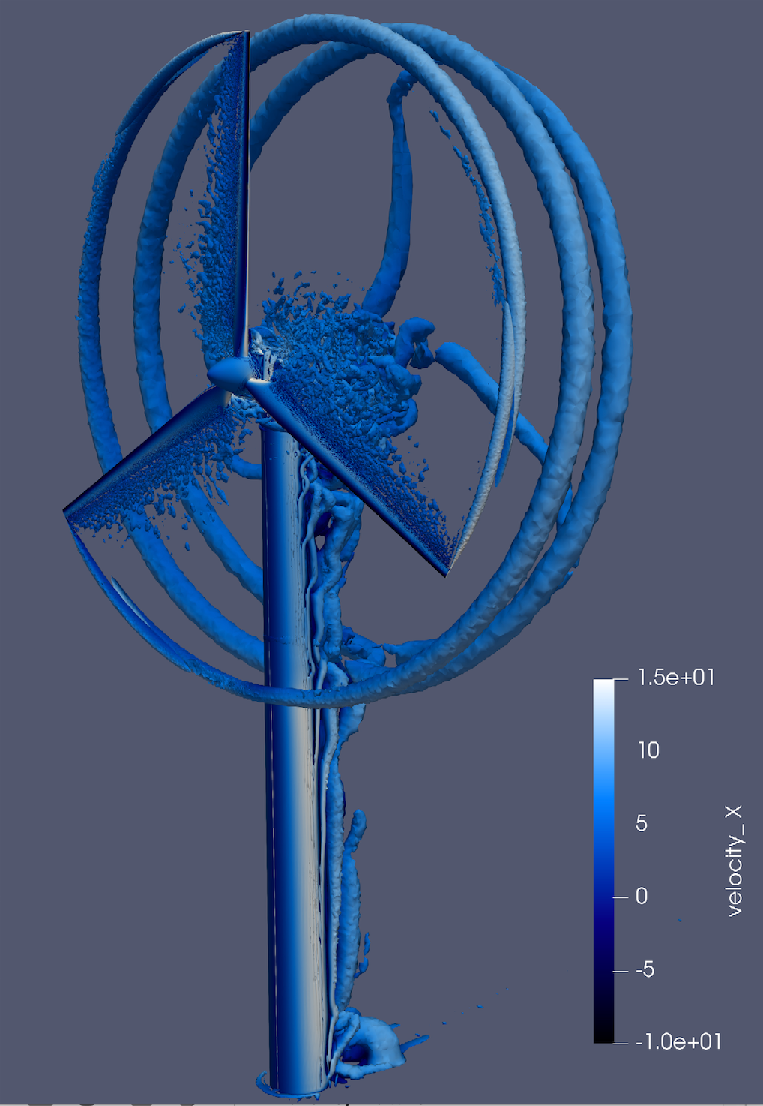
Wind Energy Applications Including Blade-Resolved Simulations
Vestas V27 225 kw wind turbine simulation

Slide 9
SPD Computational Fluid Dynamics Research Interest: Conclusion
Interest ranges from turbulent, reacting flow (fires) to wind energy applications
Multi-physics coupling allows for very complex fluid flow simulation and predictions
Most engineering and “real-world” flows include a wide range of time and length scales
HPC enables science and the pursuit of physics modeling and insight

Slide 10
Guest Lecture Overview
SPD Computational Fluid Dynamics Research Interest
Introduction to the low-Mach Number Approximation
Common low-Mach Discretization Approaches
Splitting and Stabilization Errors
Advection Operators
A Validation Methodology: Code and Solution Verification
High Performance Computing for CFD
Multiphysics Coupling
Nalu Overview

